Slide 1
Guidelines for verifying the Transitional Credit
Narayanwal, MGSTD

Slide 2
Plan
Important Authorities to carry out verification of transitional credit
Text of Hon’ble SC order
Meaning of order
Guidelines for verification
Timelines of verification completion
Coordination
BO page of erstwhile TRAN claim
CGST TRAN credit verification details
MGST TRAN credit verification details

Slide 3
Important Authorities
Hon‘ble Supreme Court vide order dated 22.07.2022 in the matter of Union of India vs. Filco Trade Centre Pvt. Ltd. , SLP(C) No. 32709-32710/2018
Hon‘ble Supreme Court vide order dated 02.09.2022 in Miscellaneous Application No.1545-1546/2022 in SLP(C) No. 32709-32710/2018
CBIC Circular No.180/12/2022-GST Dated 9th September 2022
MGST Circular 11T of 2022 Date 26.09.2022
CBIC Circular No.182/22/2022-GST Dated 10th November 2022
MGSTD Internal Circular No 14T of 2022 dt 25th November 2022

Slide 4
Hon’ble SC Orders
Goods and Service Tax Network (GSTN) is directed to open common portal for filing concerned forms for availing Transitional Credit through TRAN-1 and TRAN-2 for two months i.e. w.e.f. 01.09.2022 to 31.10.2022 (period is modified to 01.10.2022 to 30.11.2022)
Any aggrieved registered assessee is directed to file the relevant form or revise the already filed form irrespective of whether the taxpayer has filed writ petition before the HC or decided by ITGRC.
GSTN has to ensure that there are no technical glitch.
The concerned officers are given 90 days thereafter to verify the veracity of the claim/transitional credit and pass appropriate orders thereon on merits after granting appropriate reasonable opportunity.
Thereafter, the allowed Transitional credit is to be reflected in the Electronic Credit Ledger.
If required GST Council may also issue appropriate guidelines to the field formations in scrutinizing the claims.
All questions of law decided by the respective High Courts concerning Section 140 are kept open.

Slide 5
Meaning of SC Order
Common portal opened for filing prescribed forms for availing Transitional Credit through TRAN-1 and TRAN-2 for two months from 01.10.2022 to 30.11.2022
Transitional Credit claimed by the applicant shall be credited in his electronic credit ledger to the extent allowed by the jurisdictional tax officer through an order after carrying out necessary verifications.
Verification to be carried within 90 days from 01.12.2022 i.e. up to 28.02.2023.
All questions of law are kept open.
Order is not applicable to file revised returns under the existing laws.

Slide 6
Verification of Tran Credit (1/3)
Filed forms will be available on respective internal portals.
Self certified downloaded copy of filed forms will be submitted by TP.
Verification & order by Jurisdictional officer.
Administrative control of applicant is JO.
Verification to be started immediately after receipt of forms (online/physical).
Order of Allowance/Disallowance by following principles of natural justice.
If TRAN forms filed earlier, check whether any change.
If not, reject it by an order after providing reasonable opportunity.
If yes, proceed for verification. Refer to Annexure-I for CGST, respective State guidelines for SGST/UTGST

Slide 7
Verification … contd. (2/3)
In case other tax claim, refer the claim for verification to his counterpart officer.
For this purpose, he shall share the list of GSTINs/ARNs with the counterpart officer, in respect of which verification report is needed from him, on a weekly basis, along with an intimation of the same to the nodal officer of CGST as well as SGST through his official email ID or physically. (5.3.2)
Continue verification of self portion.
Also check whether any adjudication/appeal proceeding is pending/concluded.
If yes, officer should take a note of the relevant facts in the notice/ order, and the grounds/reasons for inadmissibility of transitional credit, if any, in the said notice/ order.

Slide 8
Verification … contd. (3/3)
Counterpart to send signed Verification report within 10 days in Annexure-II with detailed findings, amount to be allowed & disallowed. Along with detailed reasons/ grounds on which the said amount is liable to be rejected and copy of the relevant notice and/or orders.
Counterpart, if required, may call for relevant records including requisite documents / returns / invoices. (5.3.6)
Seek explanation and provide PH: If credit is partly or wholly inadmissible as per the provisions of law, then a notice shall be issued by the jurisdictional tax officer to the applicant within a period of 7 days from the receipt of report.
In case, submission is made in PH, seek comments of counterpart.
Pass a reasoned order within 15 days of PH (but by 28.2.2023) based on facts of the case, verification report, submissions made and comments thereon. Specify amount allowed.
Upload pdf copy of the order on BO/AIO/Portals for credit in electronic credit ledger.
In case, order amount is lesser than original TRAN claim, recovery as per Chapter XV.

Slide 9
Timelines
JTO to share the list of GSTINs/ARNs with the counterpart officer
Counterpart to send signed Verification report within 10 days in Annexure-II
JTO send Notice to the applicant within a period of 7 days from the receipt of report.
In case, submission is made in PH, seek comments of counterpart.
Pass a reasoned order within 15 days of PH

Slide 10
Co-ordination
Appointment of Nodal Officers in field formations. Maharashtra SGST Nodal officers (34) appointed across the State.
Ensure verification reports/comments are timely sent.
Monitor progress as per timelines as per Hon SC order.
Physical communication with DIN (CBIC Circular 122/41/2019-GST dt 5.11.2019)

Slide 11
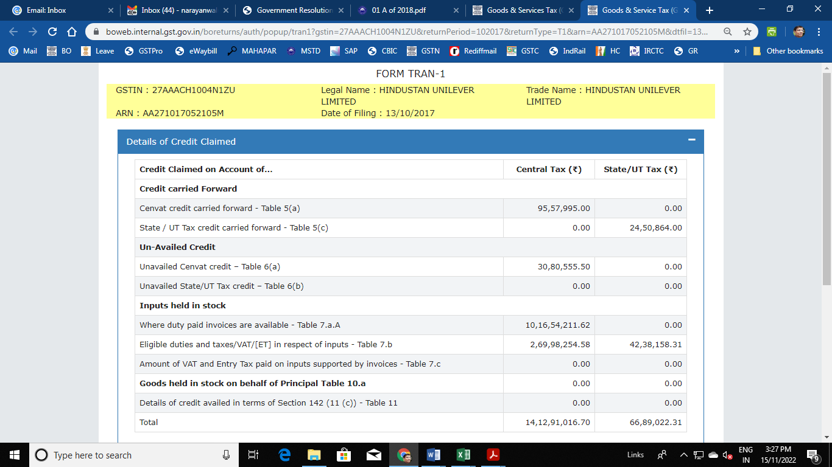

Slide 12
CGST Credit verification: Annexure-I …(1/2)
Sl No | Table/Col | Provision | Nature | Indicative Checks
1 | 5a/6 | 140(1), 140(4)(a), 140(9) | CENVAT credit carried forward in the return (ER-1/2/3 or ST-3) by mfrs & service providers | = Closing Bal in last return ER-1/2/3 or ST-3 – EC/SEC/KKC/SBC/CEC. Return for Jan’17-June’17 filed, Except all Cesses, VAT, PLA balance.
2 | 6a/11 | 140(2) | Remaining credit in respect of capital goods which has not been availed through the ER or ST return. | No duplicate with table 5a (if second instalment is claimed in 1st quarter of 2017-18. Only one instalment is allowed and not full credit.
3 | 7a/7A/6 | 140(3), 140(4)(b), 140(6) and 140(7) | By new/non-RD of of inputs held in stock and inputs contained in semifinished or finished goods held in stock based on invoice / document (incl CTD) | 1. Credit shown by registered assessee of inputs relating to exempted goods, check whether provisions of rule 6 of CENVAT Credit Rules are followed. Refer case I & II 2. CTD issued by mfr -21/2017-CE
 | 7a/7B/6 | Pro to 140(3) & 117(4) | By new who were not mfrs or service providers of inputs Only through TRAN-2. | 1. For high stock declaration, check other stock documents. Credit of only sold stock is available. 2. No declaration of this stock in other table.
Notes:
Case I: Only exempted goods/services were being manufactured or provided: Rule 6(2)
of CENVAT Credit Rules did not allow any credit in the CENVAT register if only
exempted goods were being manufactured. No credit can flow from return in relation to inputs
in such cases. The entry in table 5(a) therefore should be NIL. The apportionment of credit on
inputs and complete reversal thereof under rule 6 of CENVAT Credit Rules took place at the
time of removal of goods. Therefore, in such cases only credit of inputs and inputs contained
in semi-finished which existed in stock on the day of the transition and for which conditions
prescribed in cl (i) to (v) of section 140(3) are satisfied would be available. Where the stock
shown is very high, verification using VAT return or any other collateral document where
stocks are declared can be done.
Case II: Exempted and non-exempted goods/services were being manufactured or
provided: Rule 6(3) of the CENVAT Credit Rules provided the procedure for
apportionment of credit relating to taxable goods/services and reversal of credit relating to
exempted goods/services. Credit in table 5(a) would flow from the return in such cases. It
should be checked that the return reflects credit after application of rule 6(3) of CENVAT
Credit Rules. The reversal in terms of rule 6(3) was required to be done at the time of removal
of finished goods. Therefore some credit in Table 7A can arise for such inputs which were in
stock and which not attributed till the date of the transition to either exempted goods or nonexempted
goods. To avail credit on such inputs, other conditions prescribed in cl (i) to (v) of
section 140(3) are required to be satisfied. Where the stock shown is very high, verification
using VAT return or any other collateral document, where stocks were declared, can be done.

Slide 13
CGST Credit verification: Annexure-I …(2/2)
Sl No | Table/Col | Provision | Nature | Indicative Checks
4 | 7b/8 | 140(5), (7) | inputs or input services which were received after 1.7.2017 but taxes on which were paid under the existing law. Includes ISD. Not applies to Capital goods. | Duty paying document exists and it is recorded in books of a/c. Check transport proof for exorbitant quantity. Conditions for availing ISD are satisfied.
5 | 8/9 | 140(8) | By centrally registered units. For distribution of credit claimed in Table 5a. | Receiving units have not filed TRAN 1 to avail this credit as this would lead to double credit to receiving unit. Credit in the ledger of the distributing centrally registered unit was reduced by the amount of credit distributed
6 | 11/7 | 142(11)(c) r/w 118 | Credit of VAT and Service Tax both were paid, before 1st July 2017, on any supply but the supply is made after 1.7.2017. | Service tax claimed as credit was indeed paid under the existing law and supplies were indeed made after 1.7.2017. Credit of VAT cannot be taken as CGST credit and vice-versa.
Credit which is being claimed through TRAN 1/TRAN-2 is not taken through return in FORM GSTR-3B. Clarifications issued vide circular no. 33/07/2018-GST dated 23.02.2018 regarding disputed/blocked credit.

Slide 14
SGST TRAN credit verification … 1/5
TRAN-1 Table | Description of Table | Method of verification as mentioned in
5 (a) | Amount of credit carried forward to Electronic Credit Ledger as State tax (Section 140(1) and 140(4)(a) | Para 2.4.3 of Internal Circular No. 01A of 2018 dt 1st Jan 2018. Para 3 of Internal Circular No. 23A of 2018 dt 1st Sep 2018, Para 2 and 3 of Internal Circular No. 35A of 2019 dt 19th Oct 2019.
5 (b) | Details of statutory forms received for which credit is being carried forward (Period:01-04-2015 to 30-06-2017)
5 (c) | Amount of credit carried forward to Electronic Credit Ledger as State tax (For all registrations on the same PAN and in the same State)
6 (a) | Amount of unavailed input tax credit in respect of capital goods carried forward to electronic credit ledger as State tax (section 140(2)) | Para 4 of Internal Circular No. 23A of 2018 dt 1st Sep 2018
6 (b) | Amount of unavailed input tax credit carried forward to electronic credit ledger as State tax (section 140(2))
7 (a) | Amount of taxes on inputs claimed as credit excluding the credit claimed under Table 5(a) (under sections 140(3), 140(4)(b) and 140(6)) | Para 5 of Internal Circular No. 23A of 2018 dt 1st Sep 2018
7 (b) | Amount of eligible taxes/VAT/ET in respect of inputs or input services under section 140(5) | Para 7 of Internal Circular No. 23A of 2018 dt 1st Sep 2018
7 (c) | Amount of VAT and Entry Tax paid on inputs supported by invoices/documents evidencing payment of tax carried forward to electronic credit ledger as SGST/UTGST under sections 140(3), 140(4)(b) and 140(6) | Para 5, 6 and 8 of Internal Circular No. 23A of 2018 dt 1st Sep 2018
5(a), 7(c) and 10 | In case of transitional credit claim by builder and developers under sections 140(1), 140(6) and 142(11)(c) | Para 8 of Internal Circular No. 23A of 2018 dt 1st Sep 2018

Slide 15
State Tax: Table 5(c) Rule 140(1) & 140(4)(a) … … 2/5
All Normal registered taxpayers (non-composition)
Amount of TRAN credit claimed is admissible as ITC under MGST
Furnished all the returns for 6 months (Jan-Jun ‘17) under existing laws
Units under PSI Scheme have not claimed the set-off or refund u/r 79
Amounts carried forward in ORIGINAL returns only
Amount shall not exceed credit carried forward shown in the return of June-2017
Credit of ITC as attributed to the inter-State sales (Form-C), Branch Transfer/ Consignment Transfer (Form-F), or deemed export (Form-H), sales to Special Economic Zone (Form-I) Not received to be reduced. Verification of declarations shall only be done for the carried forward periods.
Check if any application is filed for refund of the MVAT Credit shown excess in the return for the period ending June-2017

Slide 16
State Tax: Table 7(b) Rule 140(5) … 3/5
Credit of VAT and Entry Tax in respect of the inputs received on or after the 1st July 2017
Invoice relating to such goods is recorded in the books of account of such person within a period of thirty days from the appointed day i.e. on or before the 30th August 2017 or period extended by Joint Commissioner.

Slide 17
State Tax : Table 7 (c) Rule 140(3), (4)(b), (6) … 4/5
140(3):
1. ITC claim on purchases from mega units or units availing the benefits under PSI Scheme and where the set-off is claimed under rule 52A or rule 52B.
2. Inputs or goods are used or intended to be used for making taxable supplies under GST.
If ITC is claimed under existing law, claim here is admissible.
invoice or other prescribed documents (issued bet 1.7.2016-30.6.2017) evidencing payment of tax
140(4)(b): Column 7(a) & 7(c) - The tax payer shall be entitled to take credit of VAT and Entry Tax in respect of inputs held in the stock and inputs contained in semi-finished or finished goods held in the stock (not being immovable property)
7(c) Building construction: Tax payers paying taxes under composition scheme @ 1% u/s 42(3A). Transitional credit of inputs already used in construction and contained in WIP as on 30.06.2017 is not admissible – definition of goods- semi finished & finished.
In case a builder was paying taxes as per the provisions of rule 58 i.e. at a normal rate then Table 5(c) is correct.

Slide 18
State Tax : Table 10 Rule 142(11)(c) … … 5/5
The works contracts which are continued on or after the 1st July 2017 the said supplier would be liable to pay tax (GST) irrespective of the fact that the said Developer has discharged the liability under MVAT Act, on the value stated in the registered agreement or has paid the tax in respect of the advances received or on billed amount, on or before the 30th June 2017
So, Proportionate VAT paid to the extent of the supply made on or after the 1st July 2017 determined as per the provisions of section and 142(11)(c)
2(59) “inputs” meaning thereby any goods other than capital goods used or intended to be used by a supplier in course or furtherance of business.
2(52) “Goods” to mean every kind of movable property other than money and securities but includes actionable claim, growing crops, grass and things attached to or forming part of the land which are agreed to be severed before supply or under a contract of supply.

Slide 19
Thank you
Manojkumar Narayanwal
Narayanwal@gmail.com
9987335808

